Slide 1
Material Design
Zach Hudson

Slide 2


Material Design
What is it?
Material Design is Google’s design language for all of its applications, devices, and services. It involves the color, shape, movement, and even writing style of all of Google’s interfaces. It was inspired by paper and the physical characteristics it has, such as shadows and layering.

Slide 3
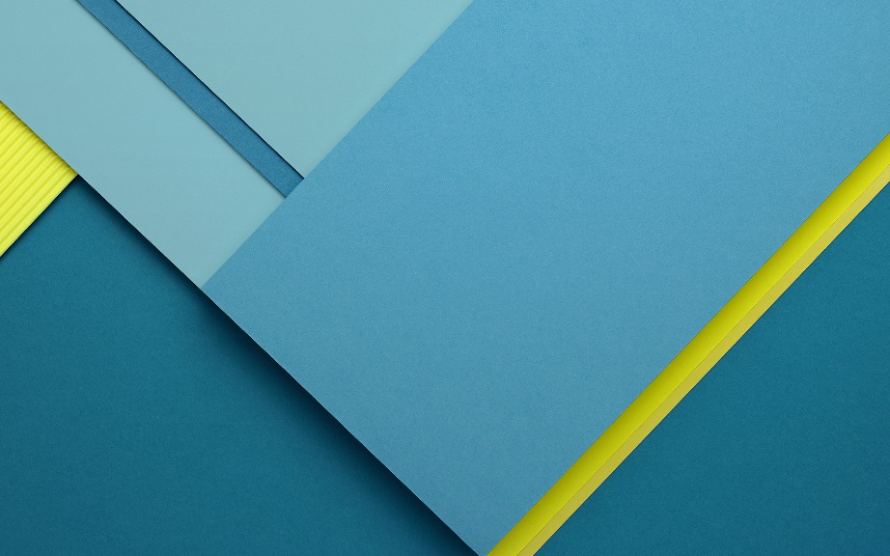
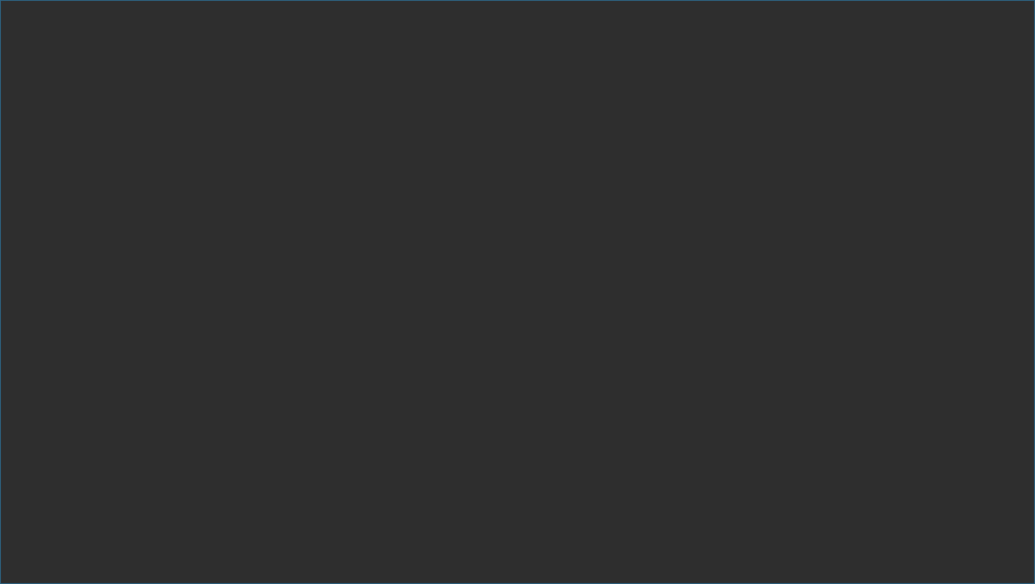






Material Design
Topics
What is it?
Material Design is Google’s design language for all of its applications, devices, and services. It involves the color, shape, and movement of all of Google’s interfaces. It was inspired by paper and the physical characteristics it has, such as shadows and layering.
Material
Color
Movement
Layering
Coding

Slide 4

Material

Slide 5

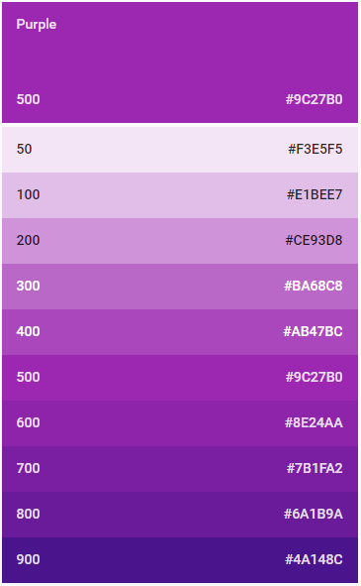
Color
Text
Text
Text
Coloring is important for all design. In Material Design, shading is what is the most important. Commonly, themes will consist of no more than 3 colors, but will include a variety of shades of those colors. The color palettes can be found on Google’s design website.
Text
Text
Text

Slide 6
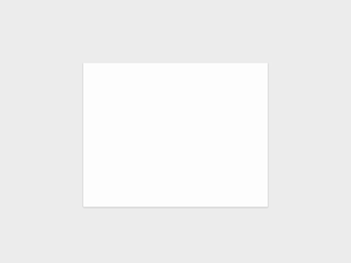
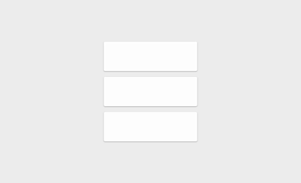
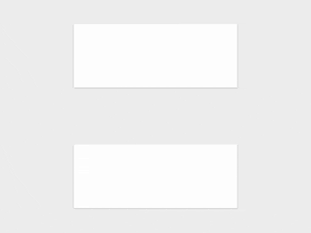

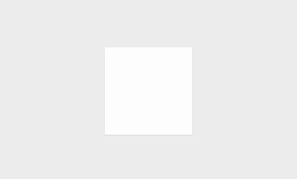
Movement
Lifts and changes shade when clicked
Sheets can go over other sheets
Can stretch, split, and reattach seamlessly
Sheets can change shape
Sheets can change size

Slide 7
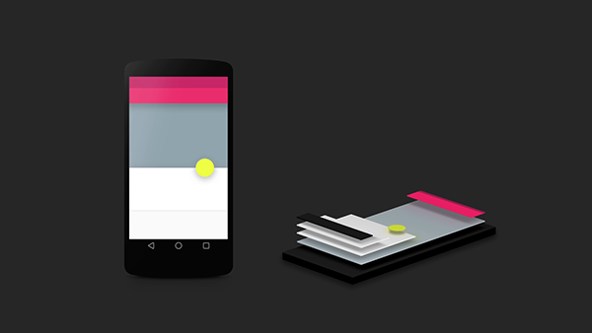
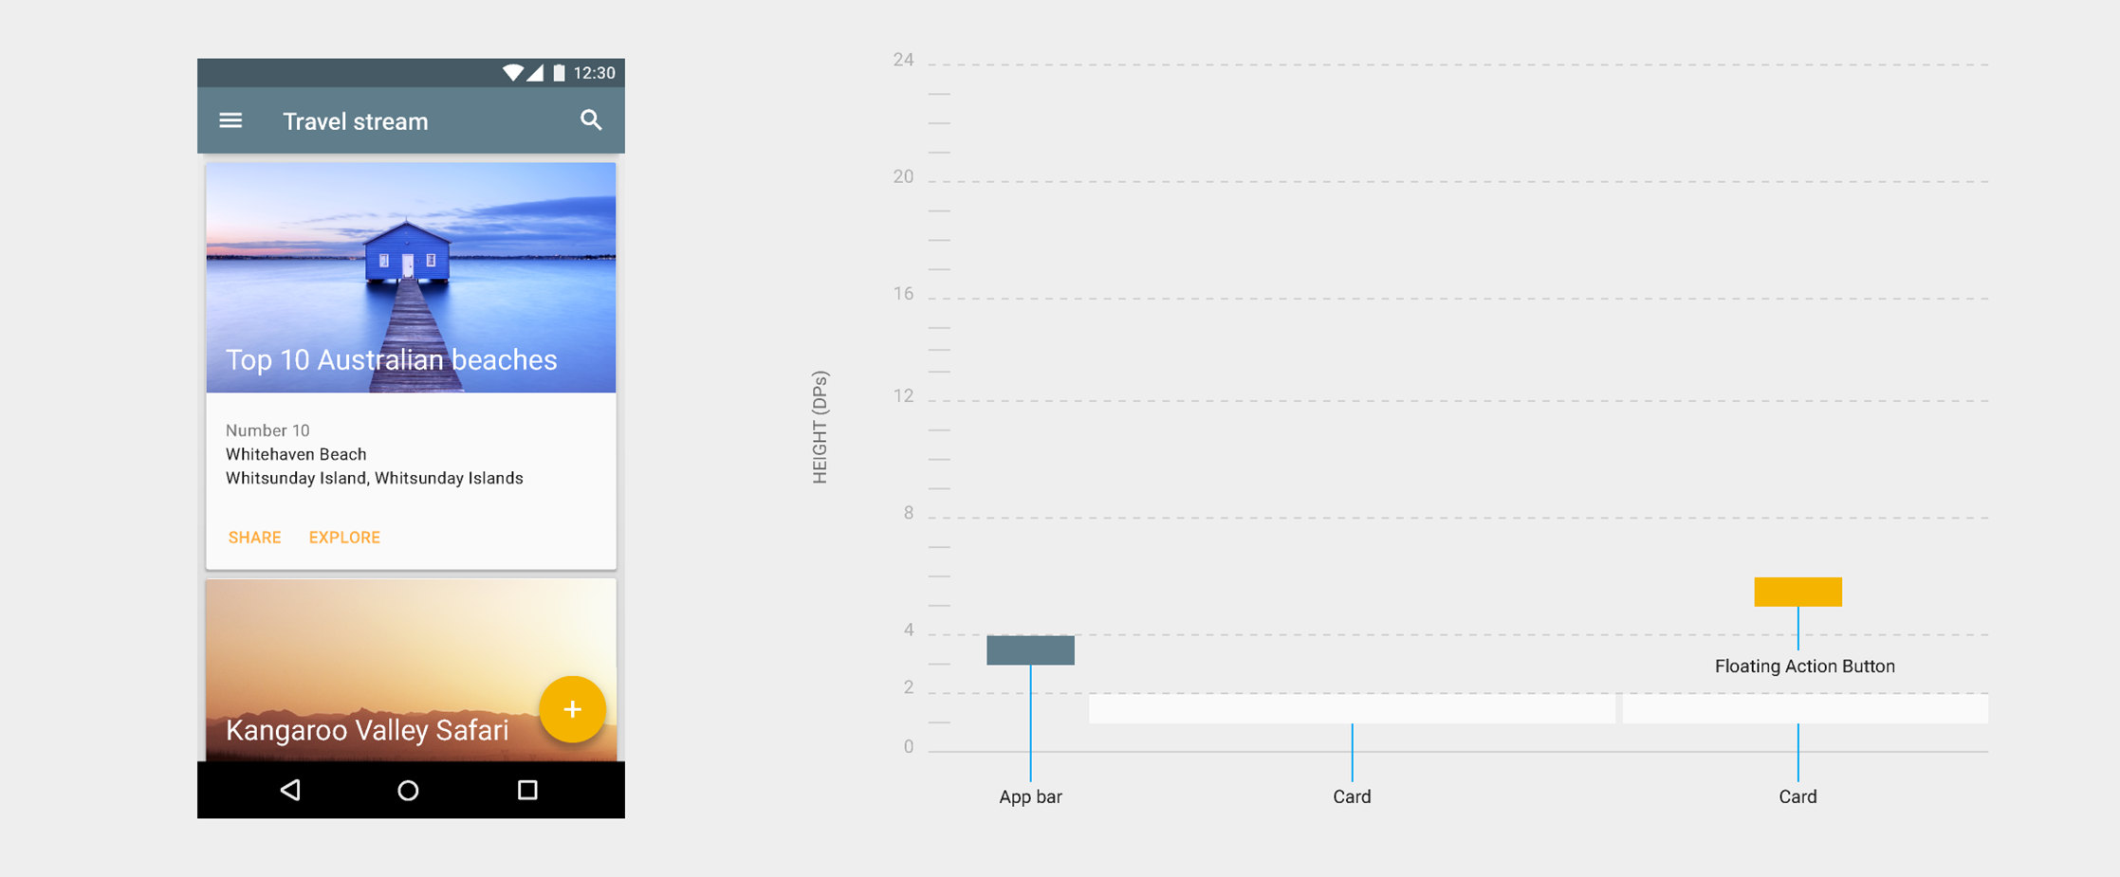
Layering
Layering of the sheets not only improves the overall look of the interface, but it also helps the user understand its properties better. Removing line borders and replacing them with shadows gives a 3D look and a clear distinction between items and other sheets.

Slide 8
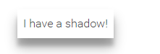
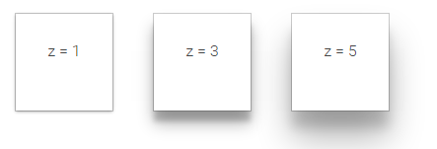
Coding
Google uses the Polymer library and basic guidelines to make sure their theme is universal. This includes shadow style and properties to help developers easily adopt the material design into their app.
<style>
.span-shadow {
display: inline-block;
padding: 8px;
}
</style>
<paper-shadow z="3" class="span-shadow">
<span>I have a shadow!</span>
</paper-shadow>

Slide 9
Resources
Material Design – https://design.google.com/
Making Material Design: Smart Paper – https://www.youtube.com/watch?v=BUzUoc2ZOIo

